Slide 1
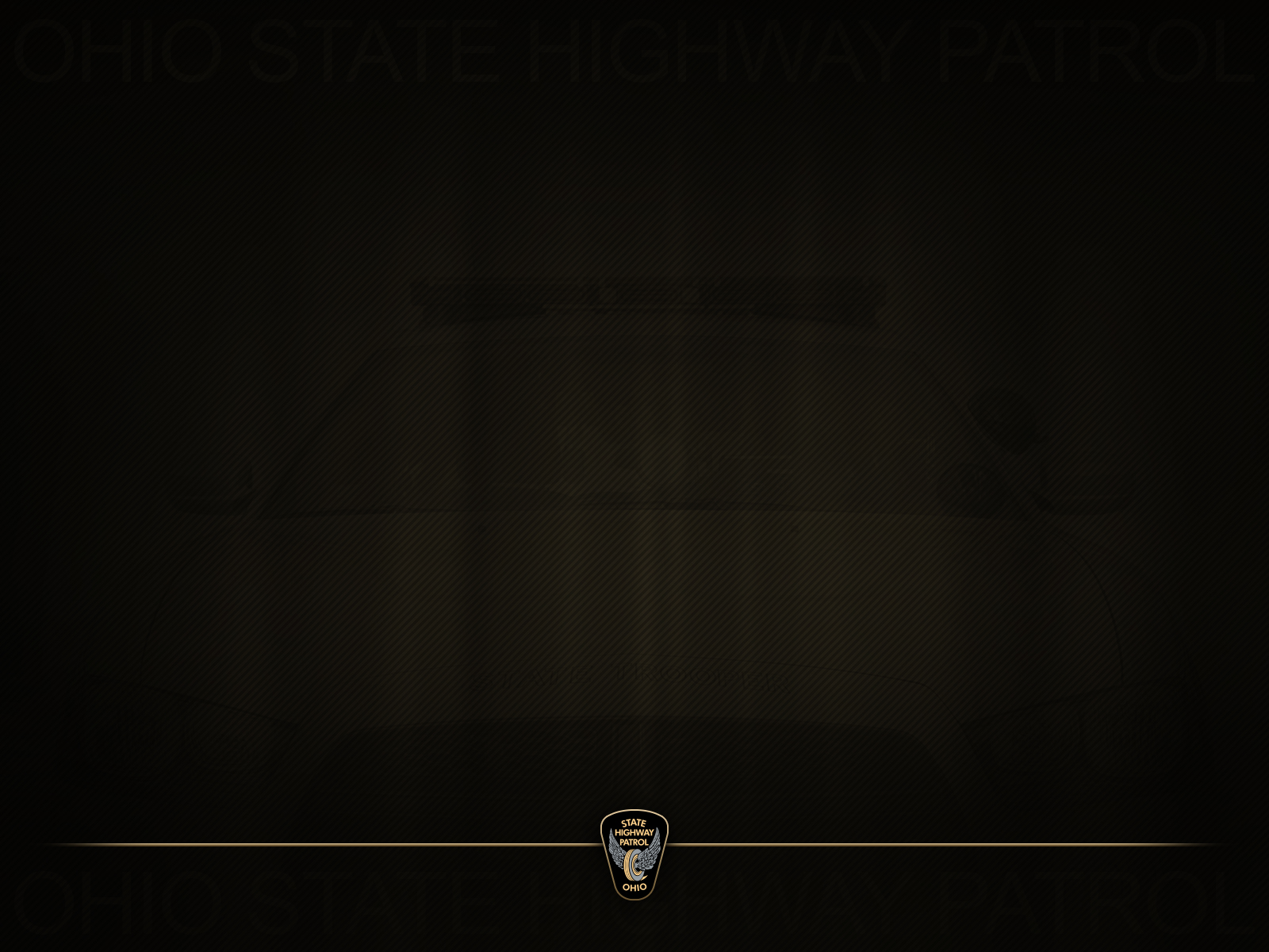
Ohio State Highway Patrol
Distracted Driving
#Itcanwait

Slide 2
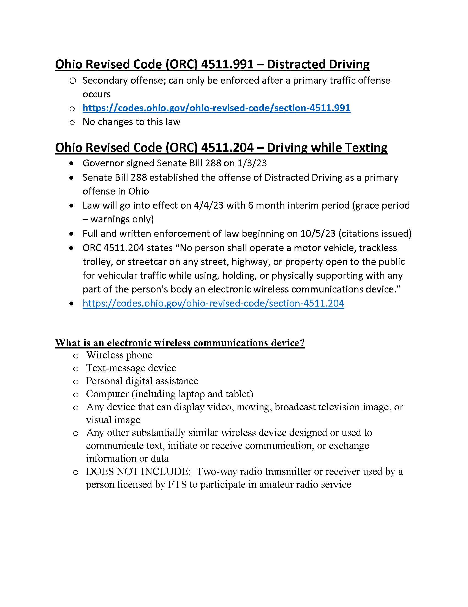
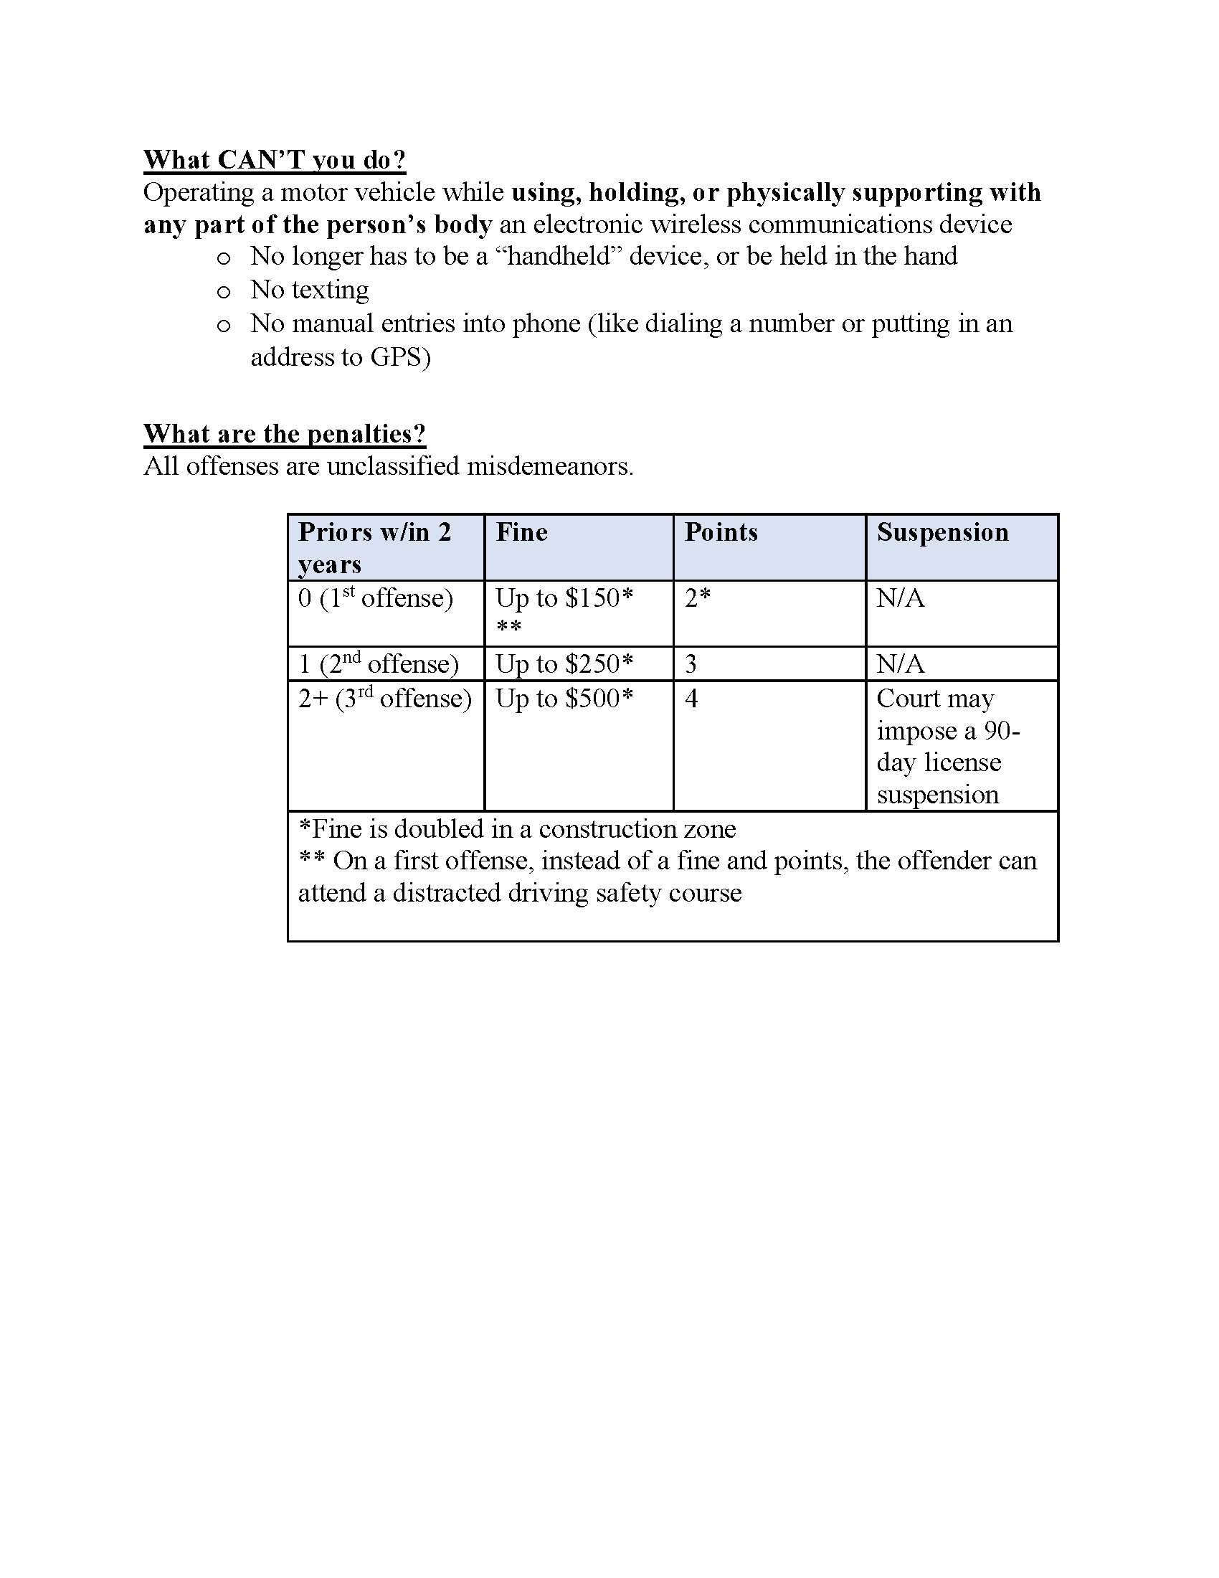
Ohio, It Can Wait!

Slide 3
Distracted Driving Crashes
From 2017 to 2021, there were 64,108 distracted driving crashes.
Male drivers made up 55% of these crashes.
1 in 3 of these crashes involved drivers between the ages of 15 and 24.

Slide 4
Fatal Crashes
From 2017 through 2021 distracted driving led to 206 fatal crashes that resulted in 226 deaths.
Males made up 64% of these fatal crashes.

Slide 5
Distracted driving crashes by county
Cuyahoga County led the state with 5,872 distracted driving crashes.
Franklin: 5,757; Hamilton: 5,065; Montgomery: 3,077; Lucas: 2,711.
These counties accounted for 35% of all distracted driving crashes.

Slide 6
Distracted driving means:
Any and all activities keeping your mind off the roadway:
- Texting or talking on the phone
- Talking to passengers
- Eating
- Reading
- Applying makeup
- Being emotionally distraught
- Blasting loud music

Slide 7
What is distracted driving?
Distracted driving is any non-driving activity a person engages in that has the potential to distract them from the primary task of driving and increases the risk of crashing.

Slide 8
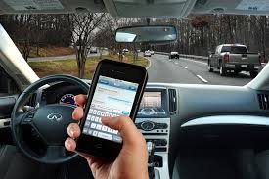
Distractions can be:
Visual – taking your eyes off the roadway.
Manual – taking your hands off the wheel.
Cognitive – taking your mind off of driving.
Texting includes all three of these!

Slide 9
Additional Consequences
In October 2018, Ohio passed house bill 95
(distracted driving penalties increased).
If the distraction was a contributing factor to the commission of the violation, there will be an additional $100 fine.
Is your text worth it?

Slide 10
Ohio, It Can Wait!

Slide 11


Ohio State Highway Patrol
Questions? Comments? Personal Experiences?
www.statepatrol.ohio.gov
facebook.com/OhioStateHighwayPatrol
@oshp

